Slide 1
Module 3
ERM in the Marketplace and Implantation at an University

Slide 2
Chapter 8
Housing Association Case Study of ERM in a Changing Marketplace

Slide 3
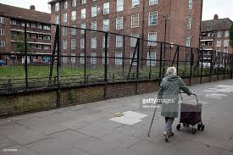
Notes:
Uk housing market has major issues exponentially increased by Brexit – pg 119
Number of households is expanding by 250,000 per year
Rate of building is only have of requirement
Banking sector not able to fund further growth
4 Real estate associations handle ERM differently within the British real estate markets
London & Quadrant – 70,000 households – largest associations with strong financial position – pg 125/126
Mix of intermediate rent, market rent, and houses for sale for London and South East
Invented number of innovative financial instruments and renting regimes to foster high growth
South Wales Association – (RCT Homes Limited) - 10,000 homes – pg 126
Based in Welsh valleys to north of Cardiff (depressed areas)
Social enterprise subsidiaries to help provide employment in the areas
Participating in risky joint venture hoping to build 1,000 units mainly in the northern hinterland of Cadiff – prosperous Welsh capital
Specialist Association – (Ability Housing Association) – 550 housing units – pg 126
Focus on disabled housing living in South England
Partners with other agencies to focus on flexibility and tailored services
Medium Sized Association – (GreenSquare Group) – 11,000 properties – pg 126 & 136
Formed from two associations into one entity to take advantage of synergies
Mixed portfolio of housing product lines and support activities

Slide 4
Chapter 9
Lessons from the Academy: ERM Implementation in the University Setting

Slide 5
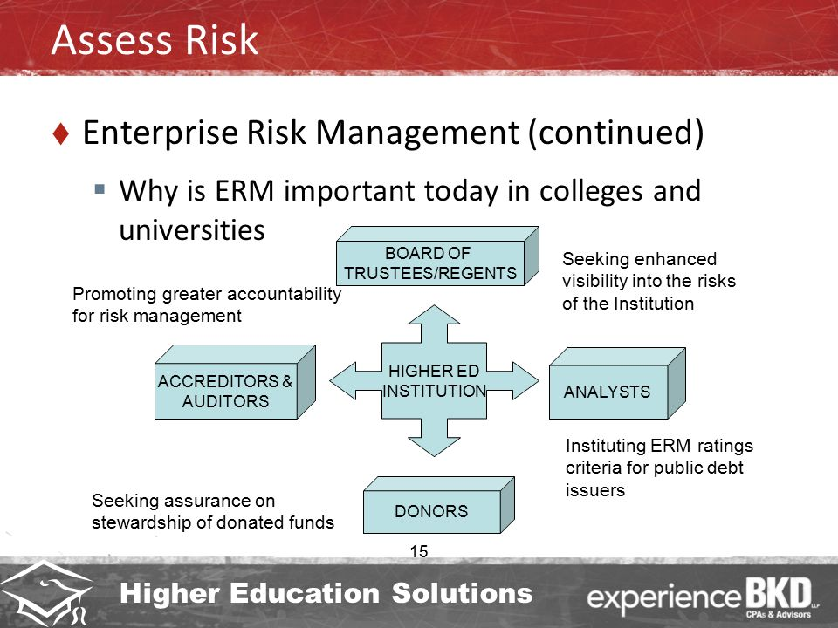
Notes:
Historical perspective as colleges and universities outside the normal business world
Organizational academia versus operational business
Five models of organizational functioning by Bimbaum – pg 146
Collegial – Higher educational models – Extensive committee systems
Bureaucratic – Typically follows normal business hierarchy – belief in rationality
Political
Anarchical
Cybernetic
Types and increase in variety of risks pushing higher education to embrace normal business practices – pg 168
Competition for faculty
Increased accountability – board, students, staff
External scrutiny – Government, public and governing boards
IT changes
Increased litigation
Important to ask 3 questions to mitigate top leaders dealing with details – pg155
What is the mission
What is the strategy to achieve the mission
What risks might derail the organization from achieving the mission

Slide 6
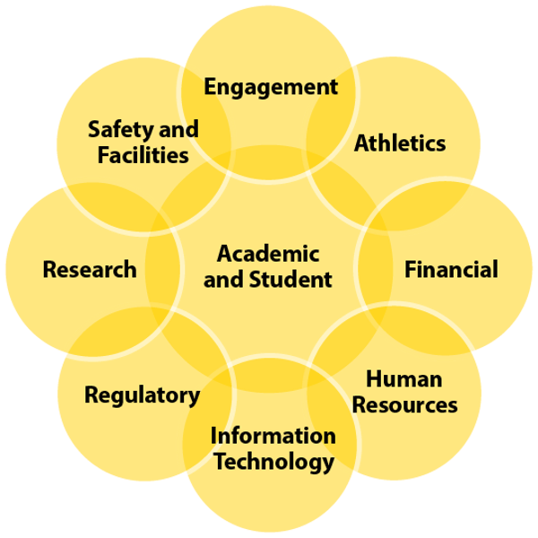
Notes:
Early ERM were not written with higher education in mind and were often presented in such complicated formats and details that it made any interest in implementing ERM systems a large obstacle - 153
University of Washington 3 silos structure important for risk analysis –pg157
Undergraduate
Graduate
Professional
SRIRC – Strategic Risk initiative Review Committee was created to investigate best practices in university risk management and make recommendations about structure and framework for compliance that would fit into UW culture - 159
Compromised of a broad array of university representatives that would ensure different view point
Add additional buy-in from different silo’s for overall University integration
Main focus for University of Washington was the integration of ERM beyond the insurance approach and away from reactive ad hoc solutions – pg 161
COSO ERM adopted model – pg 167
Process effected by board of directors, management , other personnel, applied in strategy setting and across the enterprise
Designed to identify potential events that may affect the entity, manage risk within the risk appetite, provide reasonable assurance regarding the achievement of entity objectives

Slide 7
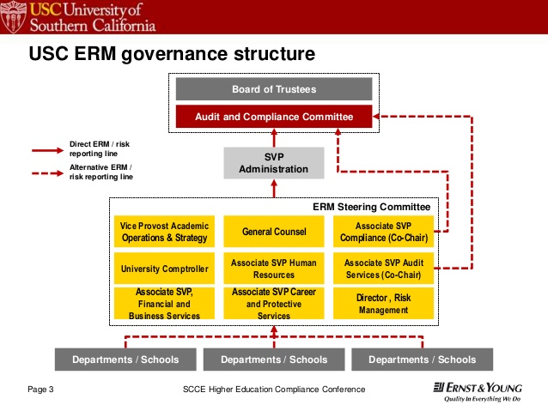
Notes:
APPENDIX 1: ROLES WITHIN THE ERM GOVERNANCE STRUCTURE
UW Units Take and Manage Risks 1. Ownership of activities which give rise to risk
2. Risk and/or opportunity identification and unit level assessments
3. Develop strategies and take action to mitigate risks
4. Encouraged to share assessment results with ERM program
ERM Program Monitor and Aggregate 1. Establish ERM framework, standards, and templates
2. Monitor and participate in risk committees for the purpose of providing the enterprise view
3. Provide admin. support, summary information and analysis to COFi and PACERM
4. Train the trainer
COFi Council Oversee 1. Oversight over functional areas of risk
2. Identify and prioritize cross-functional issues (e.g., risks, responses, internal controls, measures)
3. Identify topics for outreach
PACERM Advise 1. Advise the University President on management of risks and opportunities which may significantly impact strategic goals or priorities
2. Recommend policy changes or actions to reduce risk
3. Oversight of entity level assessments
Internal Audit Validate 1. Independent verification and testing of internal controls
2. Oversight of changes in audited units (e.g., Internal Audit risk map)
3. Provide admin. support, summary information and analysis to COFi
UW President and Provost Acknowledge 1. Verbally acknowledge key documents such as: • ERM Framework • PACERM and COFi Council Charters • Entity level assessments • Reports to Regents
2. Integrate PACERM advice into UW strategic priorities
3. Establish policies and procedures based on PACERM recommendations

Slide 8
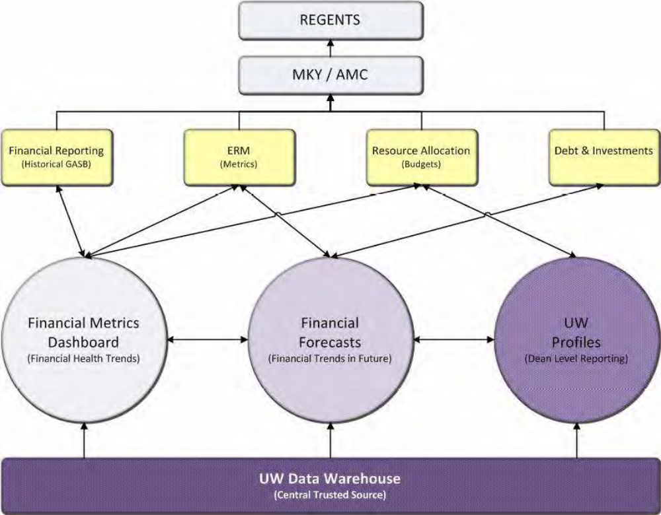
Taken from: University of Washington Enterprise Risk Management 2012 Annual Report – pg 7

Slide 9
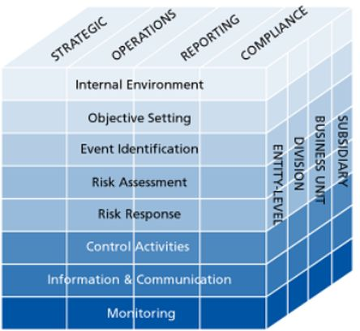
https://www.bing.com/images/search?view=detailV2&ccid=jORtIq4a&id=3CEDA2F7B6910FF2802F0C5DBF2EDCED870B6472&thid=OIP.jORtIq4aNQAcbiT24HX5LwEsEU&mediaurl=http%3a%2f%2fwww.raamstijn.nl%2feenblogjeom%2fimages%2fstories%2fcoso%2520raamwerk%2520erm%2520risico%2520control.jpg&exph=409&expw=444&q=coso+erm+model&simid=608025147478967740&selectedIndex=13&ajaxhist=0

Slide 10
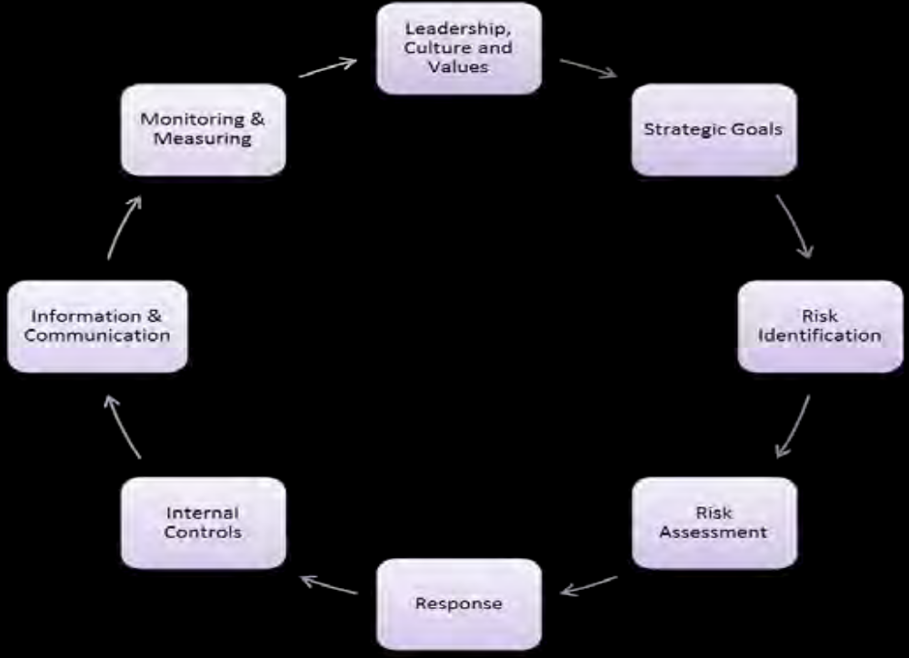
APPENDIX 2: ENTERPRISE RISK MANAGEMENT PROCESS OVERVIEW
Taken from: University of Washington Enterprise Risk Management 2012 Annual Report – pg 13

Slide 11
References
John R.S. Fraser, B. J. (2015). Implementing Enterprise Risk Management. New Jersey: Wiley & Son, Inc.,

